Slide 1


IMPLEMENTATION OF ECG AND PULSE-OXIMETER
Presented by
T.LAHARI-20FE1A04H1
S.AMEENA-20FE1A04E1
P.AKASH-20FE1A04C6
T.VAMSI-20FE1A04H0
Under the guidance of
MR.K.DAYANAND,M.TECH
ASSISTANT PROFESSOER

Slide 2
CONTENTS
ABSTRACT
INTRODUCTION
COMPONENTS REQUIRED
WORKING PRICIPLE
SOURCE CODE
ADVANTGES AND APPLICATIONS
ADVANCEMENTS
EXPECTED RESULT
COCLUSION

Slide 3
ABSTRACT
The aim of the ECG is to detect the abnormal heat rhythms
An ECG is to help diagnose and monitor conditions affecting the heart. It can be used to investigate symptoms of a possible heart problem, such as chest pain, palpitations , dizziness and shortness of breath.
Pulse oximetry is a test used to measure the oxygen level (oxygen saturation) of the blood. It is an easy, painless measure of how well oxygen is being sent to parts of your body furthest from your heart, such as the arms and legs.

Slide 4
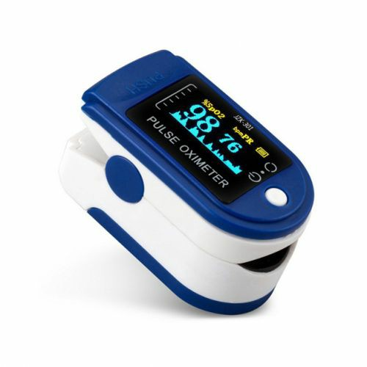
INTRODUCTION
PULSE OXIMETER:

Slide 5
It is a invansive device used to measure blood oxygen levels and can also display heartbeat
A pulse oximeter is MEDICAL DEVICE that indirectly monitors the oxygen saturation of a patient’s blood
Pulse oximeter measure:
1.The oxygen saturation of haemoglobin in arterial blood
2.The pulse rate-in beats per minute
It is safe method and simple method of assessing oxygenation
Covenient and measurement can be continuos
The maintainance of optimal 02 delivery is the core concern during anasthesia

Slide 6
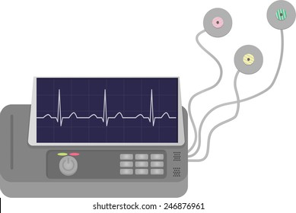
ELECTROCARDIOGRAPH:

Slide 7
F
The ecg machine is designed to recognise and record any electrical activity within the heart
It provide information about the function of the intracardiac conducting tissue of the heart and reflcts the presence of cardiac disease through its electrical properties
With each heartbeat,an electrical impulse starts from the superior part of the heart to the bottom.the impulse prompts the heart to contract and pumps blood
Understanding ecg helps to understand how the heart works
Electrical activity has two phases:
1.phase of depolaraisation
2.phase of repolarisation

Slide 8
COMPONENTS REQUIRED
Aurdino uno
AD8232 ECG SENSOR
MX30100 SENSOR
NODEMCU ESP8266
JUMPER WIRES

Slide 9
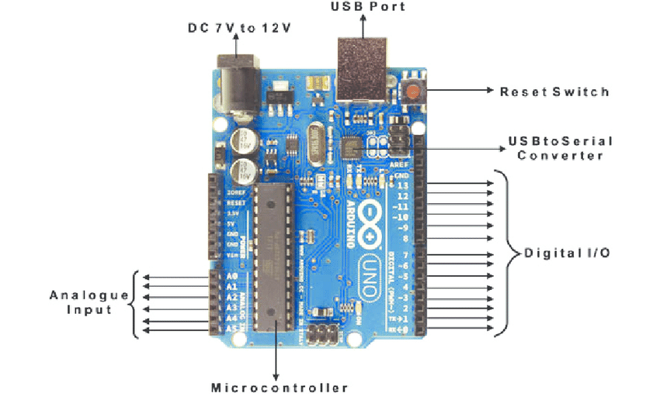
ARDUINO UNO:
The arduino uno is an open source microcontroller board based on the microchip ATmega328P microcontroller and devloped by aurdino.cc and initially realeased in 2010.
The board is equipped with sets of digital and analog inputor output pins that may be interfaced to various expansion board and circuits.

Slide 10
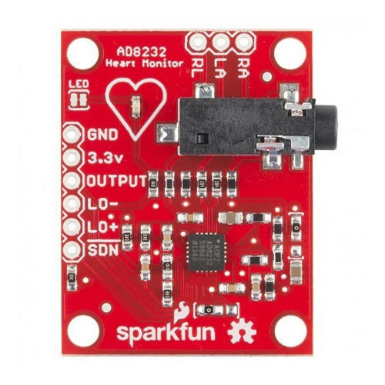
AD8232 ECG SENSOR:
The AD8232 ECG sensor is a commercial board used to calculate the electrical movement of the human heart.
Electrocardiograms can be very noisy, so to reduce the noise the AD8232 chip can be used.
The working principle of the ECG sensor is like an operational amplifier to help in getting a clear signal from the intervals simply.

Slide 11
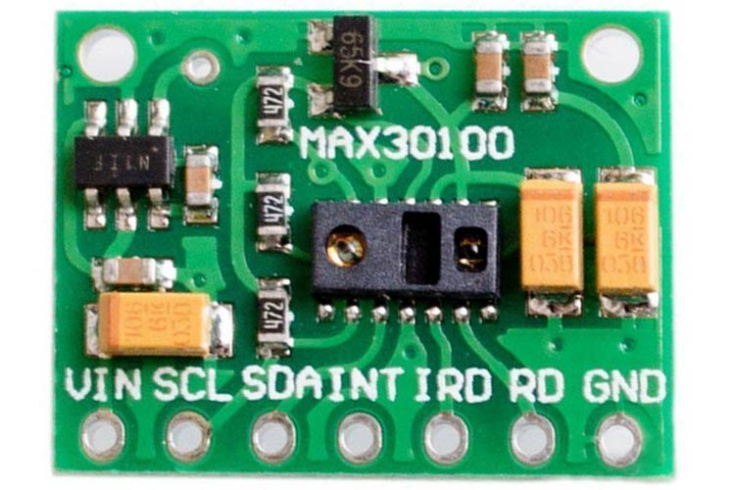
MAX30100 SENSOR:
MAX30100 is an integrated pulse oximeter and heart rate monitor sensor solution.
It combines and two LED’s photodetector, optimized optics ,and low-noise analog signal processing to detect pulse oximeter and heart-rate signals.
The sensor has two light-emitting diodes and one photodiode.The LED’s are used to emit the light and the photodiode is used to detect and measure the intensity of the receivedThe light

Slide 12
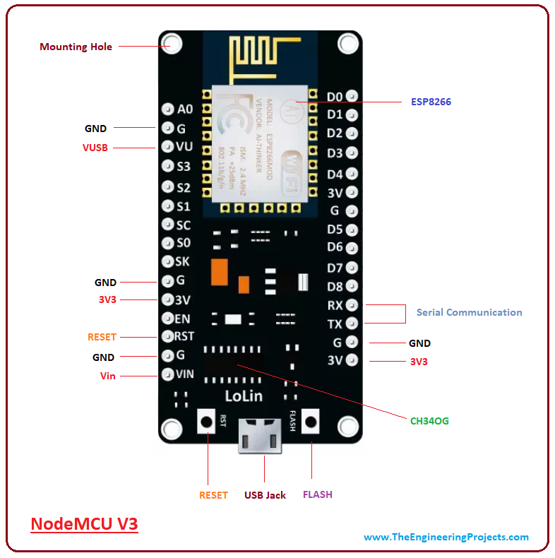
NODEMCU:
NodeMCU is an open source platform based on ESP8266 which can connect objects and let data transfer using the Wi-Fi protocol.
In addition, by providing some of the most important features of microcontrollers such as GPIO, PWM,ADC .
The advantages of NodeMCU are low cost, integrated support for WiFi networks, a smaller board size, and lower energy

Slide 13
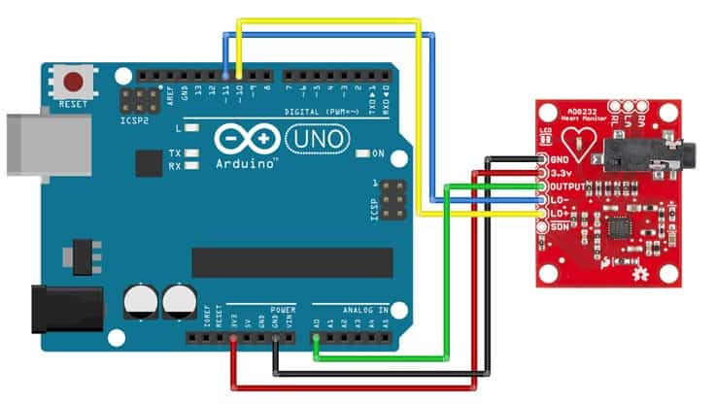
WORKING PRINCIPLE OF ECG:

Slide 14
E
It works on the principle that a contracting muscle generates a small electric current that can be detected and measured through electrodes suitably placed on the body.
The electrode picks up the current and transmit them to an amplifier inside the electrocardiograph. Then electrocardiograph amplifies the current and records them on a paper as a wavy line.
In an electrocardiograph, a sensitive lever traces the changes in current on a moving sheet of paper.
A modern electrocardiograph may also be connected to an oscilloscope, an instrument that display the current on a screen.

Slide 15
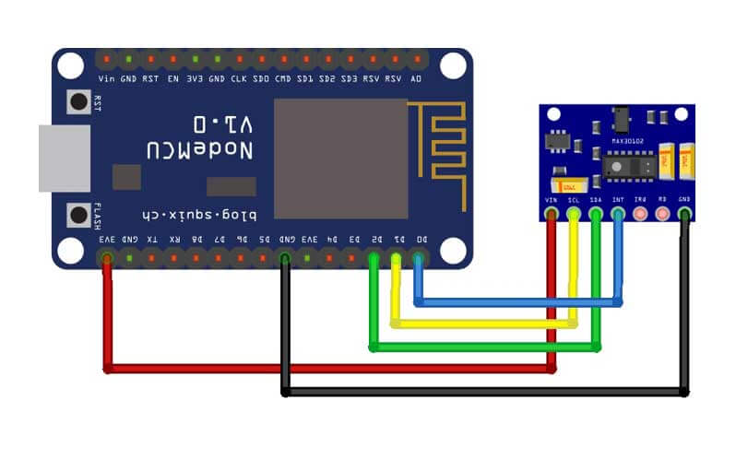
WORKING PRINCIPLE OF PULSE OXIMETER:

Slide 16
A
The device has two LEDs, one emitting red light, another emitting infrared light. For pulse rate, only the infrared light is needed. Both the red light and infrared light is used to measure oxygen levels in the blood.
When the heart pumps blood, there is an increase in oxygenated blood as a result of having more blood. As the heart relaxes, the volume of oxygenated blood also decreases. By knowing the time between the increase and decrease of oxygenated blood, the pulse rate is determined.
It turns out, oxygenated blood absorbs more infrared light and passes more red light while deoxygenated blood absorbs red light and passes more infrared light.

Slide 17
SOURCE CODE OF ECG
void setup() {
// initialize the serial communication:
Serial.begin(9600);
pinMode(10, INPUT); // Setup for leads off detection LO +
pinMode(11, INPUT); // Setup for leads off detection LO -
}
void loop() {
if((digitalRead(10) == 1)||(digitalRead(11) == 1)){
Serial.println('!’);
//serial.println(analogRead(A0);
}

Slide 18
else{
// send the value of analog input 0:
Serial.println(analogRead(A0));
}
//Wait for a bit to keep serial data from saturating
delay(1);
Serial.println(analogRead(A0));
}

Slide 19
SOURCE OF PULSE-OXIMETER:
#include <Wire.h>
#include "MAX30105.h"
MAX30105 particleSensor;
void setup() {
Serial.begin(9600);
// Initialize sensor
if (particleSensor.begin() == false) {
Serial.println("MAX30102 was not found. Please check wiring/power.");
while (1);
}
particleSensor.setup(); //Configure sensor. Use 6.4mA for LED drive
}

Slide 20
H
void loop() {
Serial.print(" R[");
Serial.print(particleSensor.getRed());
Serial.print("] IR[");
Serial.print(particleSensor.getIR());
Serial.println("]");
}

Slide 21
APPLICATIONS AND ADVANTAGES OF ECG:
APPLICATIONS:
1.fitness and activity heart rate monitors
2.portable ECG remote health monitors
3.gaming peripherals
4.biopotential signal acquisition
ADVANTAGES:
ECG helps to prevent heart attacks by analyzing heart parametets at the initial stage.
ECG is used to detect the cardiac conditions of the patients after surgical or any other operation and after application of anesthesia.
ECG test is quick, painless and safe.
ECG test is cheap in cost.

Slide 22
APPLICATION AND ADVANTAGES OF PULSE-OXIMETER:
APPLICATION:
The pulse oximeter has already found a number of clinical applications outside of the operating room, such as monitoring during patient transport, respiratory monitoring during narcotic administration, and evaluation of home-oxygen therapy.
ADVANTAGES:
monitoring oxygen saturation over time.
alerting to dangerously low oxygen levels, particularly in newborns.
offering peace of mind to people with chronic respiratory or cardiovascular conditions.
assessing the need for supplemental oxygen.

Slide 23
ADVANCEMENTS OF ECG AND PULSE-OXIMETER:
ECG:
Data can be uploaded or directly sent to the doctor by using IOT technology
By using more electrodes measurements can be more accurate
PULSE OXIMETER:
Obtaining accurate pulse-oximetry readings in motion and low perfusion states, the development of a central sensor probe, miniaturization, and wireless technology are the future focus points for the ongoing development of pulse oximetry

Slide 24
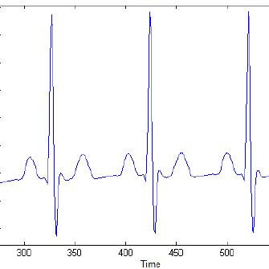
EXPECTED RESULT
RESULT OF ECG:If the test is normal, it should show that your heart is beating at an even rate of 60 to 100 beats per minute.
Many different heart conditions can show up on an ECG, including a fast, slow, or abnormal heart rhythm, a heart defect, coronary artery disease, heart valve disease, or an enlarged heart.

Slide 25
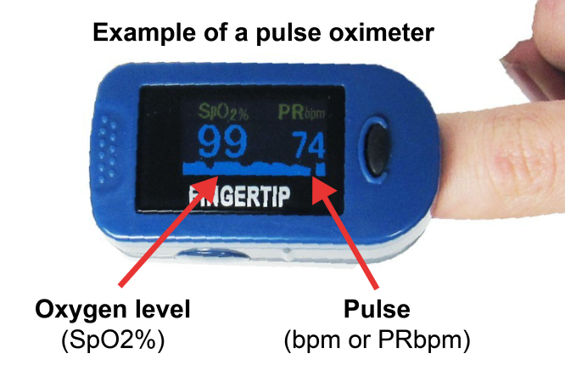
EXPECTED RESULT
RESULT OF PULSE-OXIMETER:A normal level of oxygen is usually 95% or higher. Some people with chronic lung disease or sleep apnea can have normal levels around 90%.
The “SpO2” reading on a pulse oximeter shows the percentage of oxygen in someone's blood. If your home SpO2 reading is lower than 95%, call your health care provider.

Slide 26
CONCLUSION
The 12-lead surface ECG can indicate pathological changes even before structural changes in the heart can be diagnosed by other methods. The recording of an ECG was of great value for several past generations of cardiologists and continues to provide vital information.
pulse oximetry is a simple and non- invasive way to measure blood oxygen levels and heart rate. These measurements can be used to help monitor general health and quickly assess people with lung and heart disorders.

Slide 27


